Slide 1
AUTOSAR Adapter for BUT4Reuse
SUBMITTED BY:
Mr. SAURABH YADAV
Research Assistant, LIP6, Sorbonne University
Student at Indian Institute of Information
Technology, Una, India
Batch: 2015-2019 (Roll no. IIITU15201)
SUBMITTED TO:
Dr. TEWFIK ZIADI
Associate Professor with Habilitation,
Sorbonne University & LIP

Slide 2
AUTOSAR Adapter for BUT4Reuse
This presentation is about an overview of the goals and the fundamental concepts of AUTOSAR (AUTomotive Open System ARchitecture). It also discusses all methodology, bottom-up workflow and typical migration scenarios.

Slide 3
MOTIVATION
AUTOSAR (Automotive Open System Architecture) is a standardization initiative of leading automotive OEMs and suppliers and was founded in autumn 2003. The goal is to develop a reference architecture for ECU software, which can overcome the growing complexity of software in modern vehicles.
Innovative vehicle functions are leading to a continual increase in complexity of the E/E vehicle architecture. At the same time, requirements for development are often contradictory, for example, supporting driver assistance systems in critical driving while also improving fuel economy and conforming to environmental standards. Additional challenges result from the continually deeper integration of infotainment and communication with the immediate vehicle environment and with online services.
In order to continue to meet these requirements in future, a new technological approach is required for the ECU software architecture. Without it, it will be impossible to fulfill the growing requirements of customers and legislators.
In 2003, automotive OEMs and suppliers joined together in the AUTOSAR initiative to work on this new approach. The goal of the initiative is to stem the continual repeated development of similar or identical software components. Furthermore, it aims to create a foundation for collaboration on basic functions, while leaving room for competitive development of innovative new functions. The AUTOSAR standard defined by the initiative forms the basis of future vehicle applications and helps bridge the boundaries between individual domains.

Slide 4
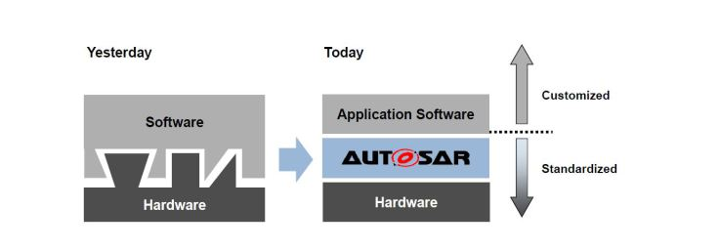
What is AUTOSAR?
AUTOSAR (AUTomotive Open System ARchitecture) is an open and standardized automotive software architecture, jointly developed by automobile manufacturers, suppliers and tool developers. AUTOSAR (AUTomotive Open System ARchitecture) is a major industry initiative to manage the growing electrical and electronic complexity in vehicles through the increased reuse and transferability of software modules.

Slide 5
AUTOSAR HAS FOLLOWING GOALS :
to fulfil future vehicle requirements, such as availability and safety, SW upgrades/ updates, and maintainability
Standardization of interfaces between functions of the application software and to basic functions
to increase a higher penetration of components across product lines
To re-use of software
to accelerate development and maintenance
to improve containment of product and process complexity and risk
to optimize costs of scalable systems
Definition of a reference architecture for ECU software

Slide 6
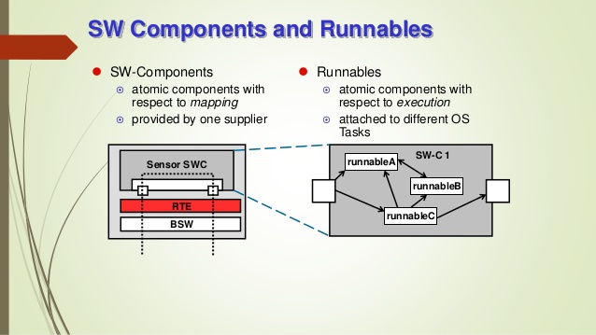
AUTOSAR Concepts :
AUTOSAR SW-C :
The AUTOSAR Software Components encapsulate an application which runs on the AUTOSAR infrastructure. The AUTOSAR SW-C have well-defined interfaces, which are described and standardized.
– SW-C Description :
For the interfaces as well as other aspects needed for the integration of the AUTOSAR Software Components, AUTOSAR provides a standard description format (SW-C Description) .ARXML files.

Slide 7
2. Virtual Function Bus :
From a general perspective, the virtual function bus can be described as a system modeling and communication concept. It is logical entity that facilitates the concept of relocatability within the AUTOSAR software architecture by providing a virtual infrastructure that is independent from any actual underlying infrastructure and provides all services required for a virtual interaction between AUTOSAR components.
As illustrated in figure in next slide, the virtual function bus is a component interconnection concept that strictly separates the domain of application development and modeling from the infrastructure. It provides generic communication services that can be consumed by any existing AUTOSAR software component. Although any of these services are virtual, they will then in a later development phase be mapped to actual implemented methods, that are specific for the underlying hardware infrastructure.
This supports reuse of SWCs across projects and platforms. The VFB is implemented for a specific vehicle by supplying a specifically configured RTE in conjunction with a suitably configured BSW for each ECU.

Slide 8
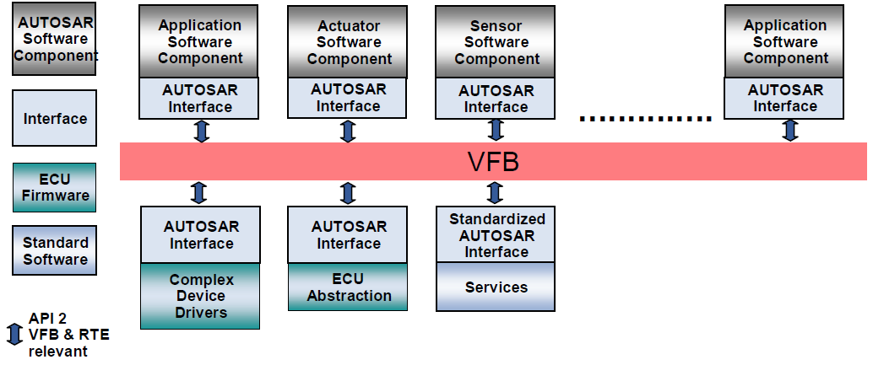
Figure : Overview on the principles of virtual interaction using the AUTOSAR Virtual Function Bus (VFB)

Slide 9
3. Runtime Environment :
In contrast to the purely virtual specification of the communication topology and interaction between components which is done via the virtual function bus, the runtime environment provides an actual implementation for these artifacts. It could also be said that the runtime environment provides an actual representation of the virtual concepts of the VFB for one specific ECU.
Each ECU has its own customized RTE implementation which is generated during the ECU Configuration process of the AUTOSAR methodology 2. The ECU mapping, i.e. the information about which component will deployed on which ECU, is part of the input of this configuration process. Depending on the location of each component, the formerly virtual interaction can then be mapped to real interaction implementation. More precisely, components that are mapped onto one ECU will communicate through Intra ECU-Mechanisms, like function calls while Inter-ECU communication will be realized using, e.g. a communication bus infrastructure. Since the RTE source code is usually generated, it can be tailored by the generator to implement
exactly the communication paths required by its connected AUTOSAR components. Thus the RTE can be seen as a static implementation of specialized communication topologies. Figure in next slide illustrates an example transformation where the components that were virtually connected via one single virtual function bus are mapped onto other ECU's.

Slide 10
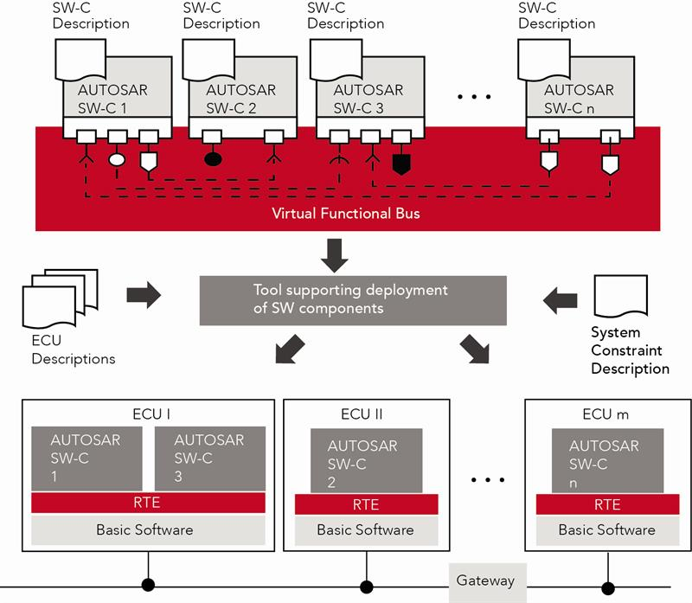
Figure : VFB to RTE mapping where the virtual communication topology is mapped to different ECU's

Slide 11
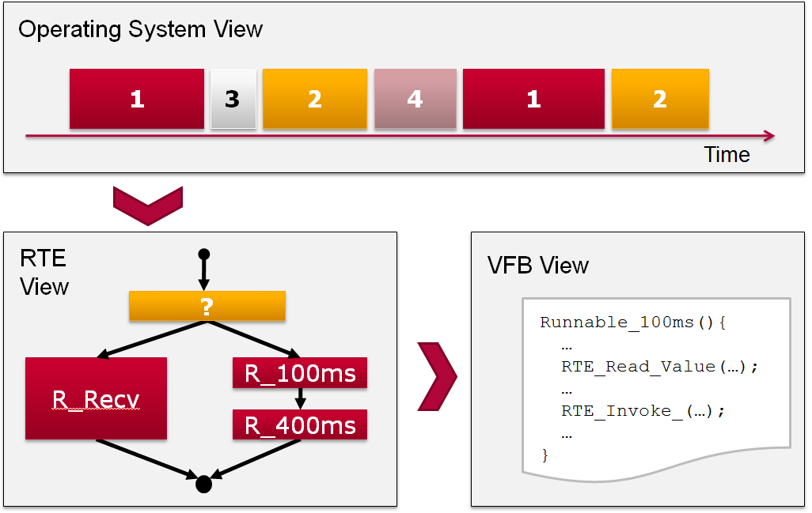
4. Runnables :
Since AUTOSAR software components have no direct access to the underlying hardware or the operating system, the implementation of the atomic software components cannot reflect artifacts like Threads or Processes. Instead, each piece of functionality that has to be executed during runtime of the software component is wrapped into a so-called Runnable. The VFB-Specification defines a runnable as a sequence of instructions that can be started by the Run-Time Environment. Each runnable that a component provides can be invoked by the RTE and is executed within the context of the underlying operating system. An atomic software component can consist of an arbitrary number of runnables of which each might have its own execution semantics. During the process of ECU configuration, a mapping between operating system tasks and existing runnables is created that is later used by the RTE to dene and perform scheduling and execution of the runnables according to their specification.
Figure : Relationship between Operating System, Runtime Environment and Virtual Function Bus with respect to the integration of runnables

Slide 12
The following source listing shows a pseudo-code implementation of a runnable body. Each runnable is encapsulated into an accordingly named function body than contains the sequence of instructions the runnable is made of. In the given example, two statements are listed that read a value from an input port and subsequently writes a value to an outgoing port :
void SeatHeating_Runnable_run1 ( ) {
...
RTE_Read_InPort_Value (...);
// do something
RTE_Write_OutPort_Value (...);
...
}
Above pseudo code is an example for the body of a runnables source code.

Slide 13
AUTOSAR Layer Model :
In AUTOSAR, the ECU software is abstracted and subdivided into basic software, runtime environment and application layer. The basic software consists of many predefined modules that are grouped into layers. The Microcontroller Abstraction Layer (MCAL), for example, offers drivers for access to memory, communication and input/output (IO) of microcontroller.The ECU Abstraction Layer offers uniform access to all functionalities of an ECU such as communication, memory or IO – regardless of whether these functionalities are part of microcontroller or are implemented by peripheral components. The Service Layer provides different types of background services such as network services, memory management and bus communication services for application layer. The operating system is also contained in this layer. The Runtime Environment abstracts the application layer from the basic software. It controls the runtime behavior of the application layer and implements the data exchange. In the application layer, the application functionality of the ECU is implemented in the form of individual software components. This layer model simplifies porting of software to different hardware. Previously, such porting required extensive adaptations at various points all the way up to the application layer in the case of poorly designed software architectures. With AUTOSAR, all that needs to be done is to replace all microcontroller specific drivers in MCAL. The modules in the ECU abstraction layer just need to be reconfigured, all other layers are unaffected by porting. This significantly reduces implementation and testing effort and associated risk.

Slide 14
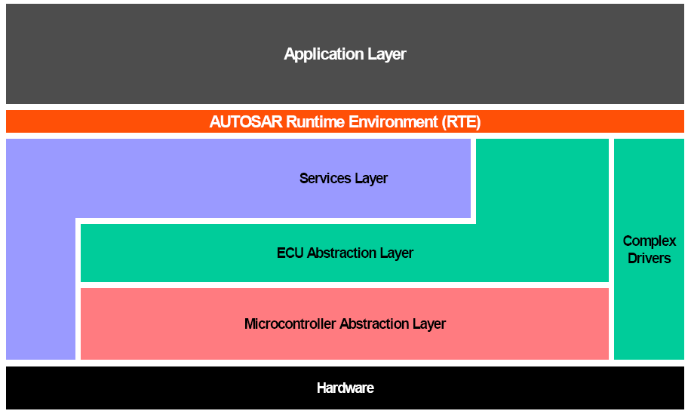
A layered architecture has been developed within AUTOSAR to enable a clear and structured interface definition and a well defined abstraction of the hardware. The architecture is structured in 5 layers plus the Complex Drivers.

Slide 15
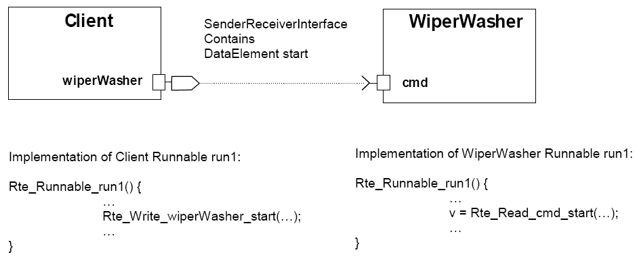
1. Application Layer :
This layer consists of AUTOSAR Software Components that are mapped on the ECUs. All interaction between AUTOSAR Software Components is routed through the AUTOSAR Runtime Environment. The AUTOSAR Interface specification assures the connectivity.
2. AUTOSAR Runtime Environment (RTE) Layer :
The AUTOSAR Runtime Environment (RTE) acts as a system level communication center for inter- and intra-ECU information exchange. The RTE is the runtime representation of the Virtual Function Bus for a specific ECU. The RTE provides a communication abstraction to AUTOSAR Software Components providing same interface and services for inter-ECU (using CAN, LIN, Flexray, MOST, etc.) or intra-ECU communication.
The RTE generator is responsible for creating the appropriate language-dependant APIs based on the definition of the interface of the component in Software Component Template. The API has to be the same independent from mapping of the components, i.e. component's code must not be changed when the mapping is changed. The API names are derived from ARXML files & conform to a naming convention.

Slide 16
3. AUTOSAR Service Layer :
The service layer consists out of 3 different parts:
Communication Services, Memory Services & System Services
The communication services are a group of modules for vehicle network communication (CAN, LIN, FlexRay and MOST). They are interfacing with the communication drivers via the communication hardware abstraction.
The memory services are a group of modules responsible for the management of non volatile data (read/write from different memory drivers). The NVRAM manager provides a RAM mirror as data interface to the application for fast read access.
The system services are a group of modules and functions which can be used by modules of all layers. Examples are real-time operating system, error manager and library functions (like CRC, interpolation etc.).
4. ECE Abstraction Layer :
The ECU Abstraction Layer provides a software interface to the electrical values of any specific ECU in order to decouple higher level software from all underlying hardware dependencies

Slide 17
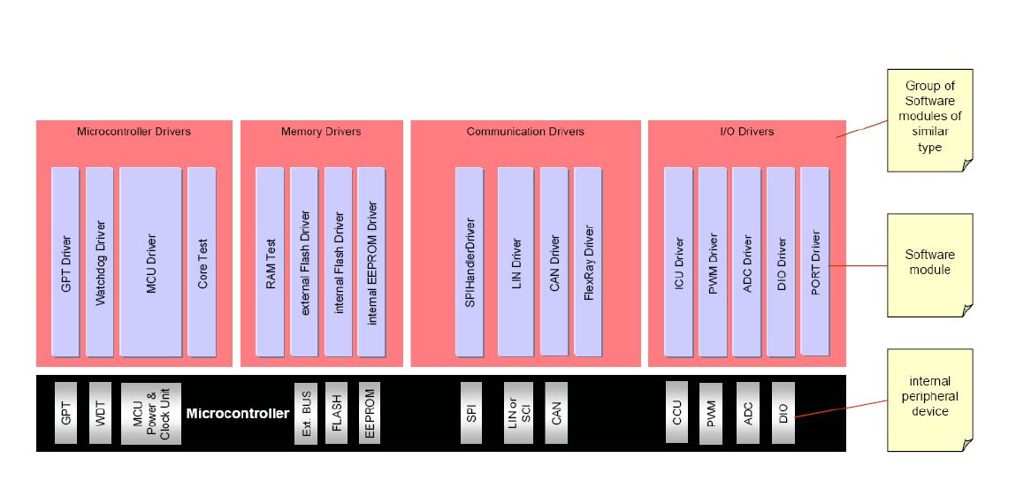
5. Microcontroller Abstraction Layer :
The Microcontroller Abstraction Layer is the lowest layer of the Basic Software. It contains drivers, with direct access to the μC internal peripherals and memory mapped μC external devices.
The Microcontroller abstraction layer is subdivided into 4 parts:
– I/O Drivers : Drivers for analog and digital I/O (e.g. ADC, PWM, DIO).
– Communication Drivers : Drivers for ECU onboard (e.g. SPI, I2C) and vehicle communication (e.g. CAN). OSI-Layer: Part of Data Link Layer.
– Memory Drivers : Drivers for on-chip memory devices (e.g. internal Flash, internal EEPROM) and memory mapped external memory devices (e.g. external Flash).
– Microcontroller Drivers : Drivers for internal peripherals (e.g. Watchdog, Clock Unit) and functions with direct μC access (e.g. RAM test, Core test).

Slide 18
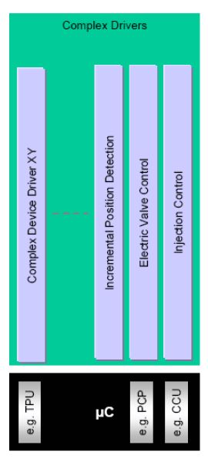
6. Complex Drivers Layer :
A Complex Driver implements complex sensor evaluation and actuator control with direct access to the μC using specific interrupts and/or complex μC peripherals (like PCP, TPU Task: Fulfill the special functional and timing requirements for handling complex sensors and actuators
The Complex Device Driver is a loosely coupled container, where specific software implementations can be placed. The only requirement to the software parts is that the interface to the AUTOSAR world has to be implemented according to the AUTOSAR port and interface specifications.
Complex Sensor and Actuator Control-
The main task of the complex drivers is to implement complex sensor evaluation and actuator control with direct access to μC using specific
interrupts and/or complex μC
peripherals (like PCP, TPU), e.g.
– injection control
– electric valve control
– incremental position detection

Slide 19
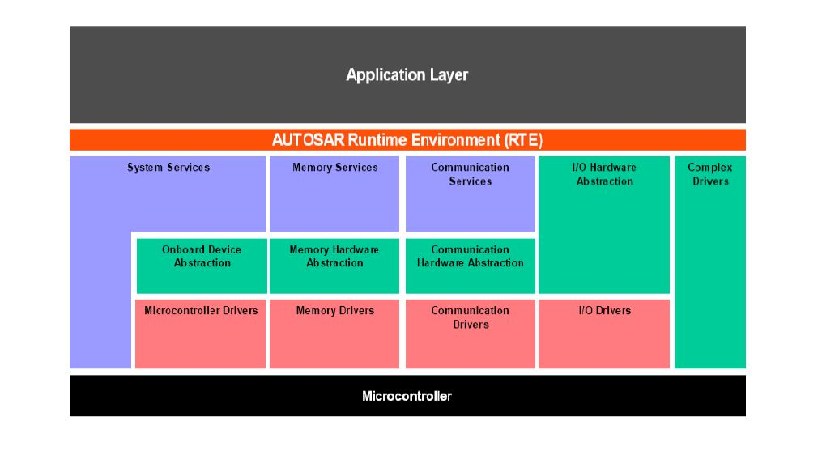
The layered architecture has been further refined in the area of Basic Software. Around 80 Basic Software modules have been defined (11 main blocks plus Complex Drivers).

Slide 20
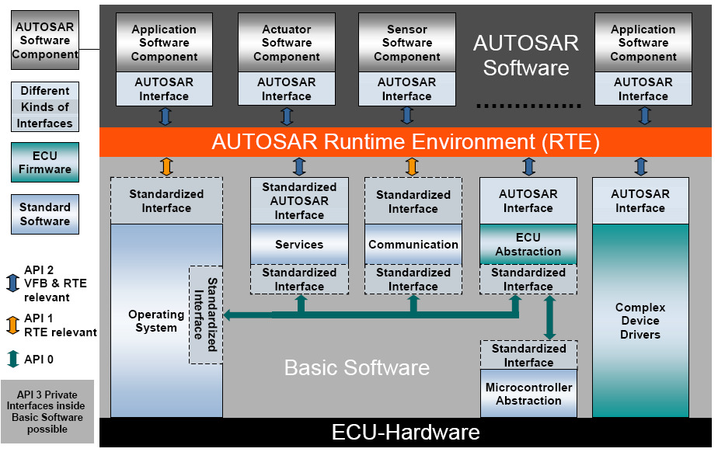

Slide 21
AUTOSAR METHODOLOGY :
The approach for developing ECU software was defined by the AUTOSAR organization in its AUTOSAR methodology. It subdivides the development process into actions and standardizes data exchange between development partners with a set of XML files.
In system design, the architecture of the application is established. This is accomplished by defining SWCs and their distribution to the ECUs. The network communication is also defined in this step. The result is the System Description – an AUTOSAR XML file, from which a specific ECU Extract of System Description is generated for each ECU.
During ECU development, the SWCs are implemented, and the BSW and RTE are configured. During the configuration, the developer defines the basic software contents that are needed for a specific project. This lets the developer optimize the entire ECU software. As a result of the configuration the developer obtains an ECU Configuration Description (AUTOSAR XML file), which is aligned with the ECU Extract of System Description.
Code generators are used to generate or modify the Basic Software component of the ECU software based on the ECU Configuration Description. The RTE is also generated to be ECU-specific.
The development of the application can be considered to be independent of this process. The interfaces of the SWCs are described in the SWC Descriptions (AUTOSAR XML file). Based on these descriptions, SWCs can be implemented and tested independently of other SWCs. This simplifies integration of application components from the OEM and the Tier 1.

Slide 22
System Configuration :
The System Configuration Input includes or references various constraints. These constraints can force or forbid certain components to be mapped to certain ECUs or requires certain implementations to be used for components. In addition, these constraints can contain resource estimations describing the net availability of resources on ECUs and thereby limiting the possible mappings.
The activity Configure System contains complex algorithms and/or engineering work. There is a strong need for experience in system architecture to map all the software components to the
ECUs. The tool AUTOSAR System Configuration Tool supports the configuration.
AUTOSAR Exchange Formats :
The following exchange formats are defined by AUTOSAR:
SWC Description: The supplier or OEM defines the SWCs. This involves creating an XML file for each SWC: the SWC Description. It describes the interfaces and the resource requirements of the SWC. The supplier or OEM then creates the relevant C files for the implementation.
System Description: The OEM first defines, based on the SWCs, the functional content for the entire vehicle independent of the ECUs. The OEM then designs the communication networks and distributes the SWCs to the existing ECUs. The results are saved in the system description.

Slide 23
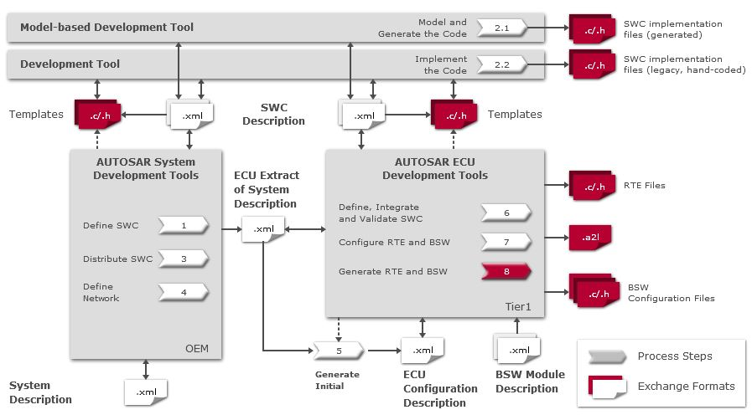

Slide 24
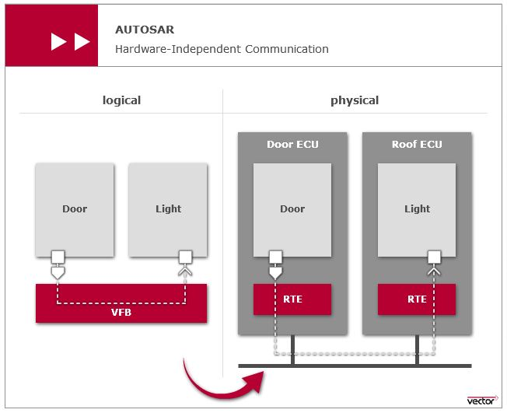
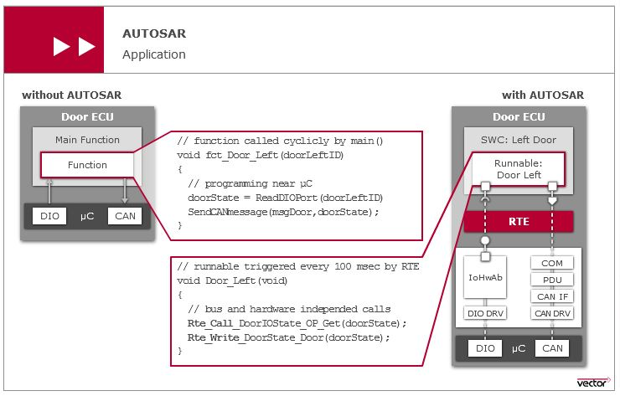

Slide 25
STEP TO STEP GUIDE FOR AUTOSAR SOFTWARE PROCESS

Slide 26
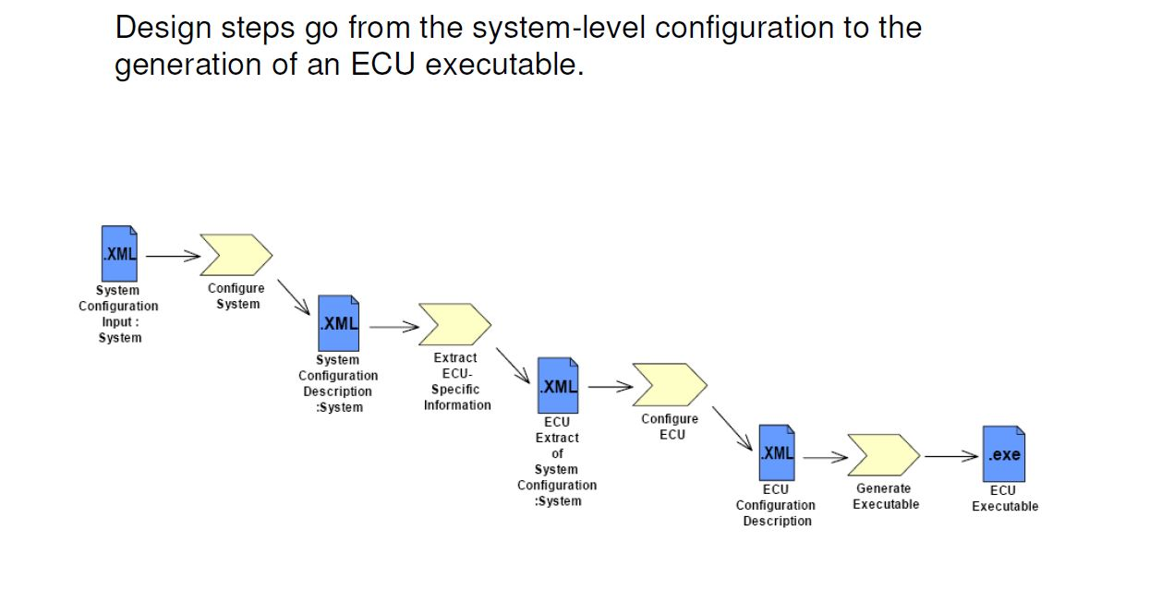

Slide 27
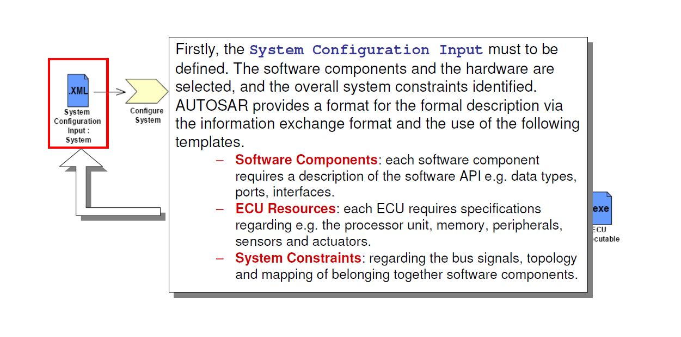

Slide 28
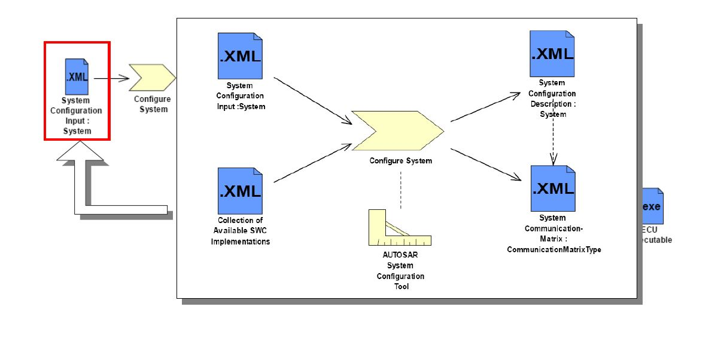

Slide 29
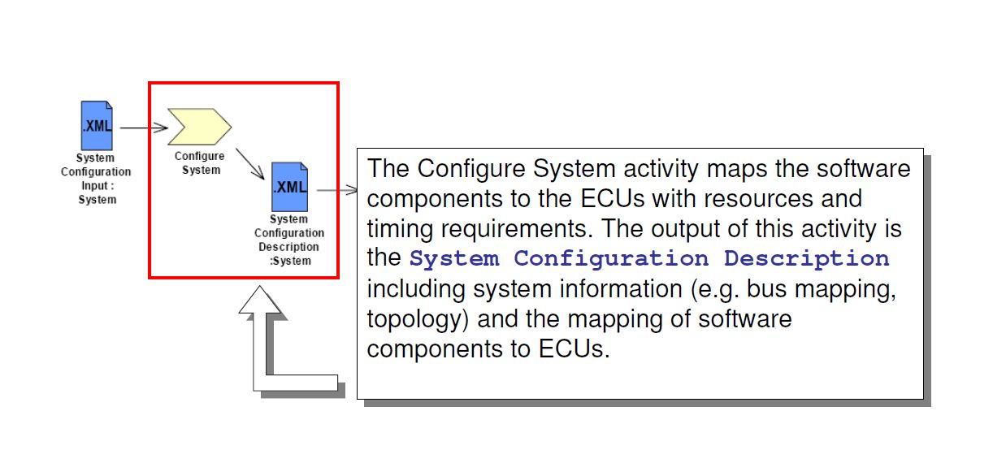

Slide 30
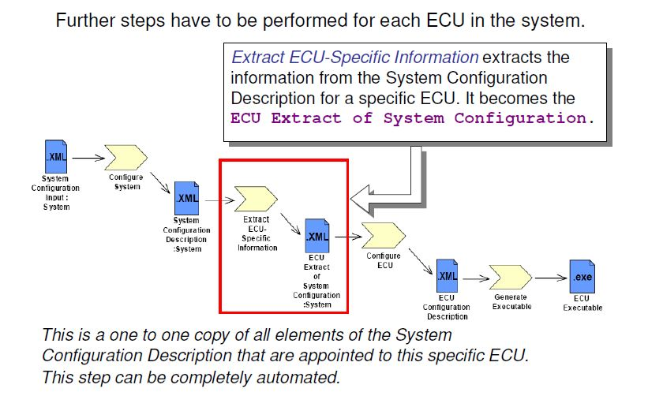

Slide 31
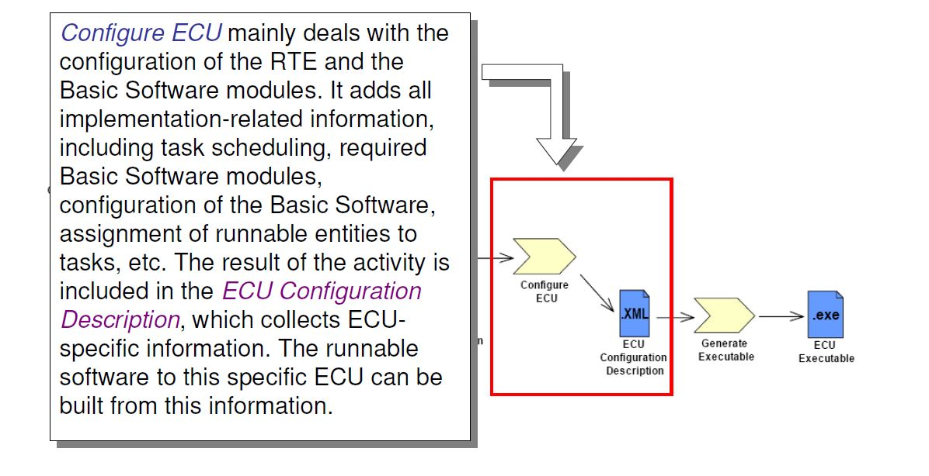

Slide 32
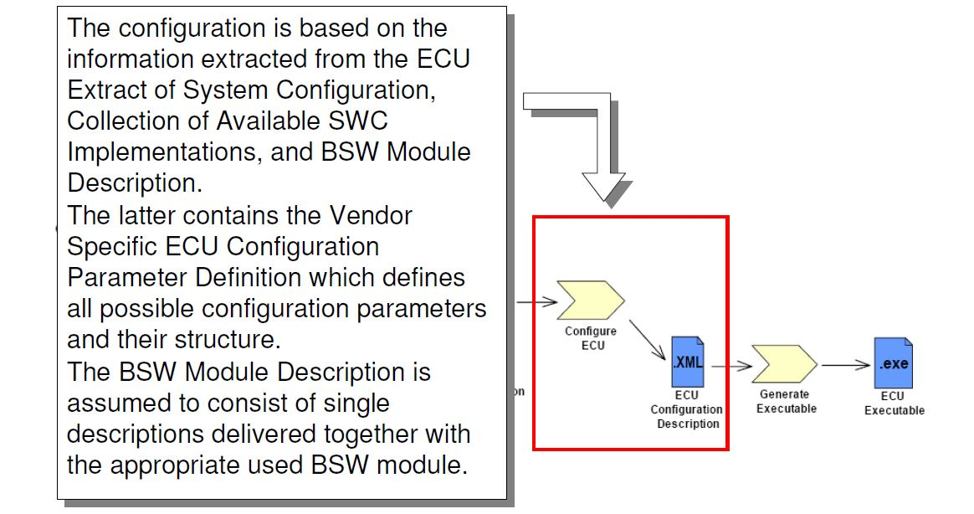

Slide 33
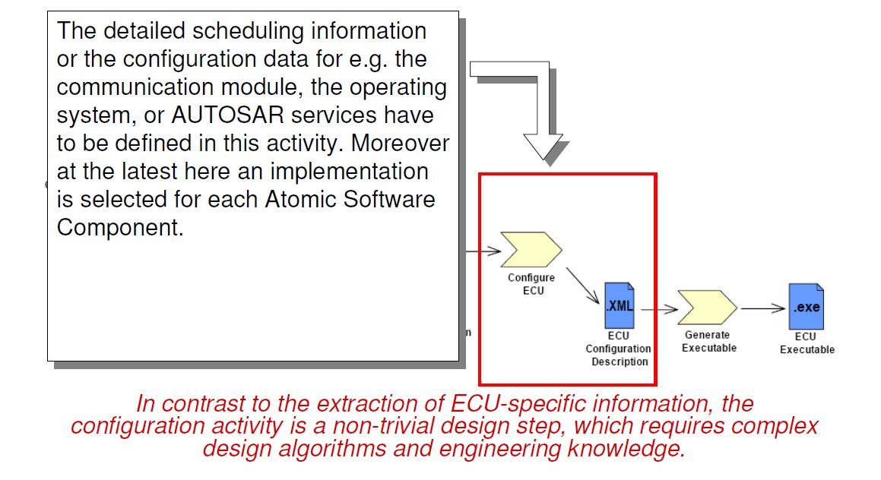

Slide 34
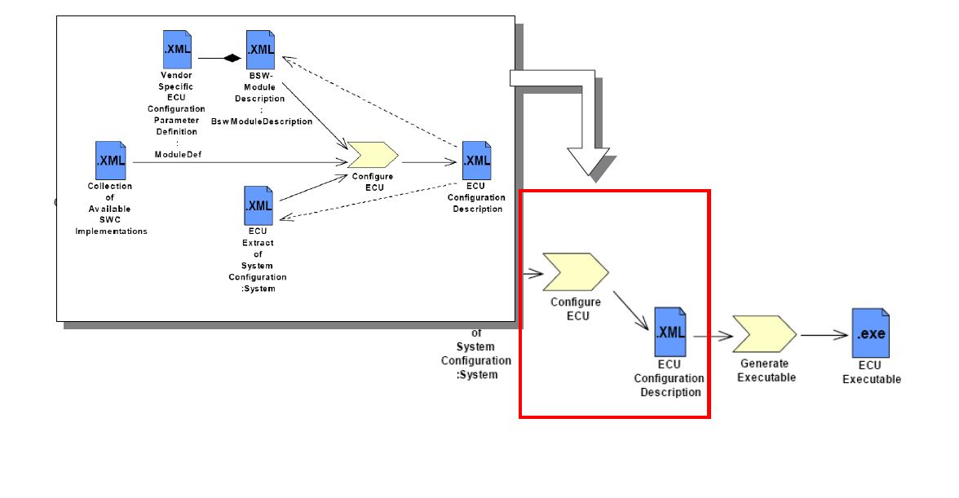

Slide 35
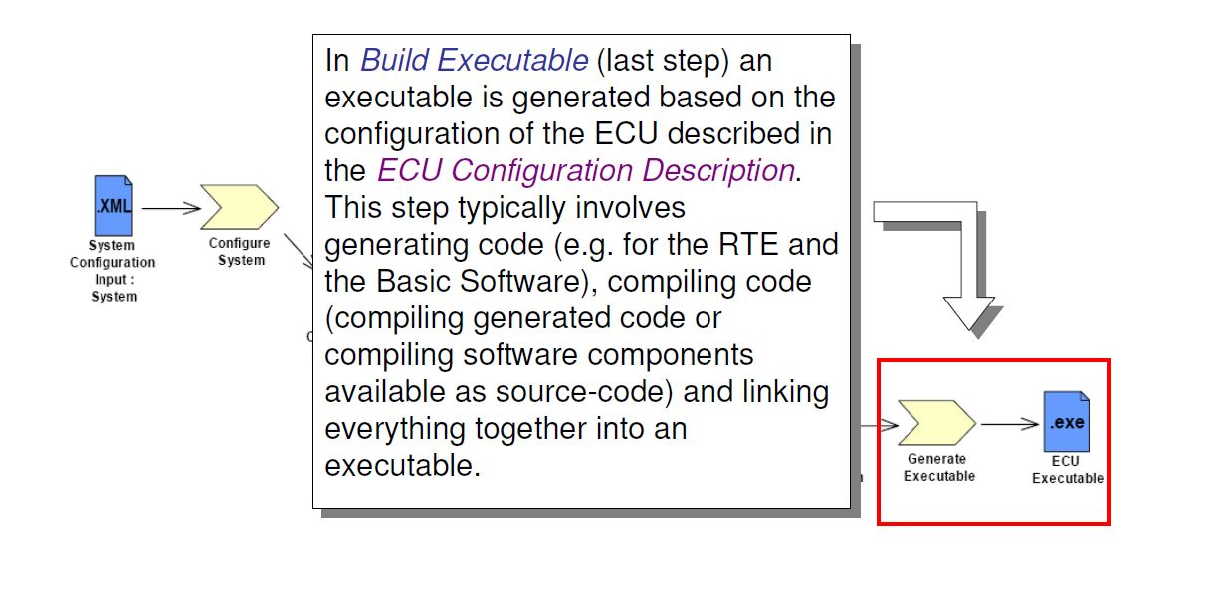

Slide 36
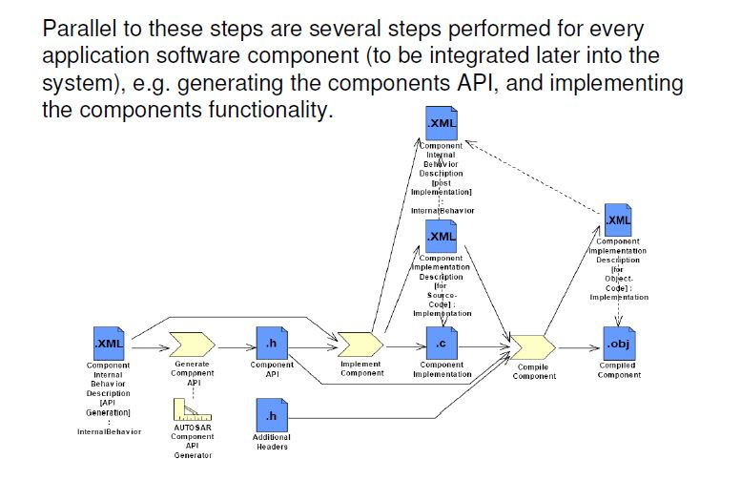

Slide 37
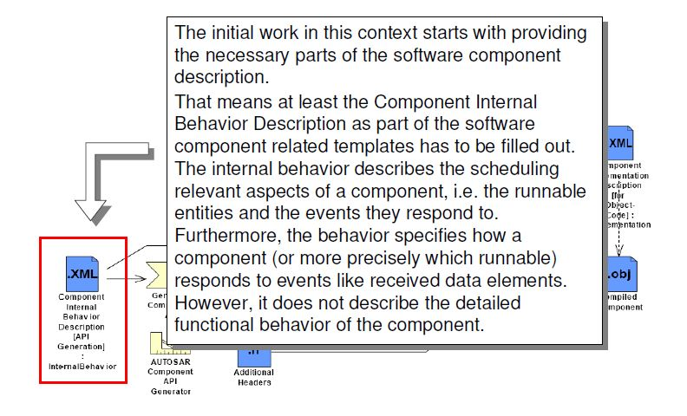

Slide 38
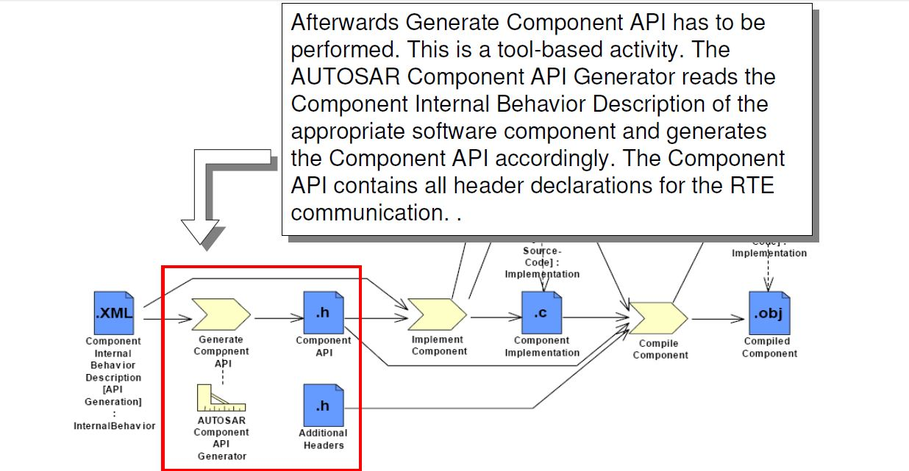

Slide 39
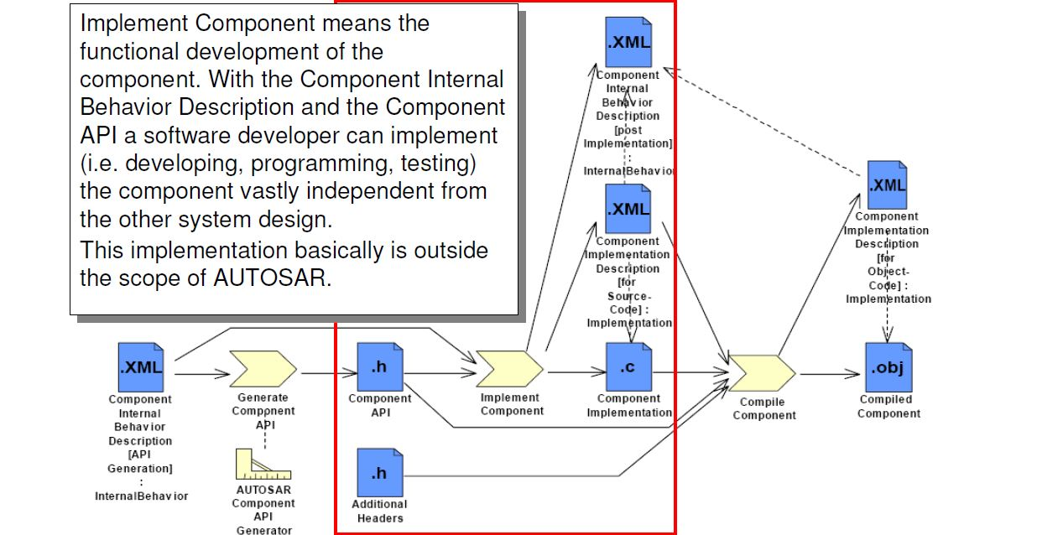

Slide 40
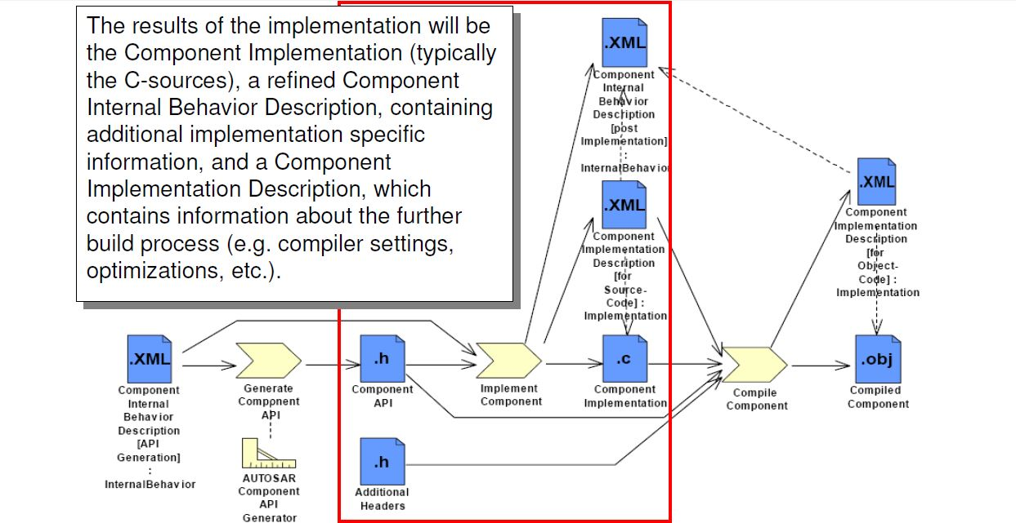

Slide 41
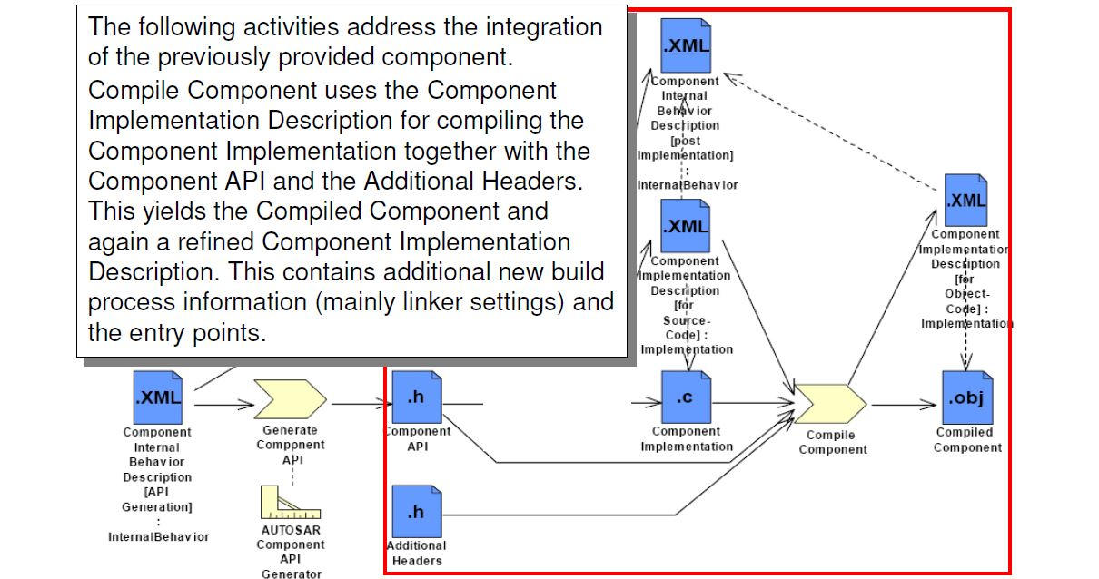

Slide 42
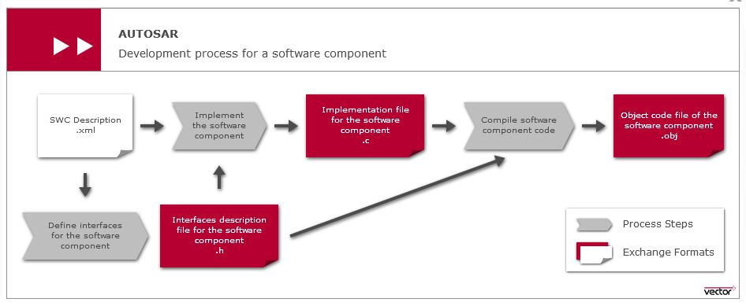
Summary :

Slide 43
Before moving further on model design, we need to know about following tools :
AAT (AUTOSAR Authoring Tool)
MATLAB (MATrix LABoratory)
Simulink
Embedded Coder
Key products for developing AUTOSAR applications :
Simulink and Stateflow® for software design
Embedded Coder for generating production code and ARXML, and for SIL/PIL verification
Third party tools for AUTOSAR authoring: Vector Informatik DaVinci Developer, KPIT Cummins K-SAR, Mentor Graphics Volcano Vehicle System Architect, ETAS ISOLAR-A

Slide 44
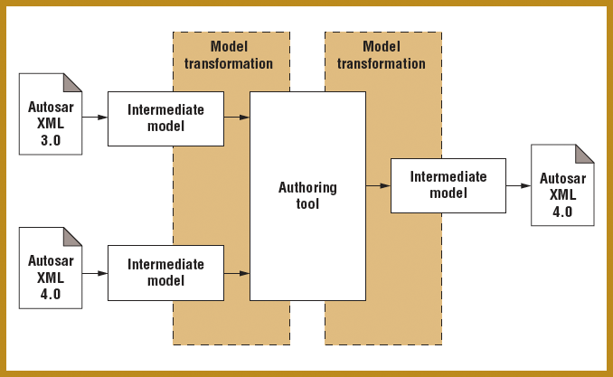
1. AAT (AUTOSAR Authoring Tool) :
An AUTOSAR Authoring Tool (Ex. DaVinci Configurator) is the central tool for configuring, validating and generating the basic software (BSW) and the runtime environment (RTE) of an AUTOSAR ECU.It’s a Software tool which supports one or more tasks in the AUTOSAR methodology, depending on the supported tasks, an AUTOSAR tool can act as an AUTOSAR authoring tool, an AUTOSAR converter tool, and AUTOSAR processor tool or as a combination of those.

Slide 45
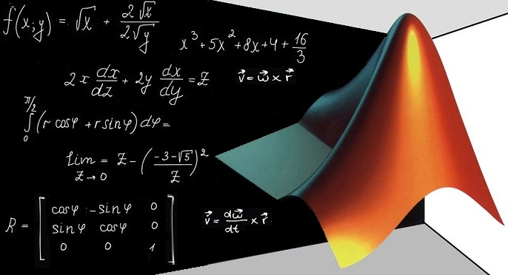
2. MATLAB :
MATLAB® is a programming platform designed specifically for engineers and scientists. The heart of MATLAB is the MATLAB language, a matrix-based language allowing the most natural expression of computational mathematics.
What can you do with MATLAB?
Analyze data
Develop algorithms
Create models and applications
The language, apps, and built-in math functions enable you to quickly explore multiple approaches to arrive at a solution. MATLAB lets you take your ideas from research to production by deploying to enterprise applications and embedded devices, as well as integrating with Simulink® and Model-Based Design.

Slide 46
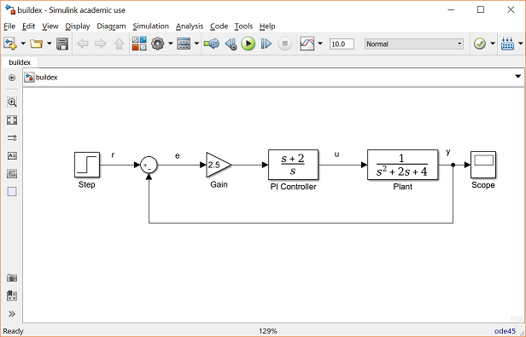
3. Simulink:
Simulink, developed by MathWorks, is a graphical programming environment for modeling, simulating and analyzing multi domain dynamical systems. Simulink® is a block diagram environment for multi domain simulation and Model-Based Design. It supports system-level design, simulation, automatic code generation, and continuous test and verification of embedded systems. Simulink provides a graphical editor, customizable block libraries, and solvers for modeling and simulating dynamic systems. It is integrated with MATLAB®, enabling you to incorporate MATLAB algorithms into models and export simulation results to MATLAB for further analysis.
Figure shows how a Simulink model look like.

Slide 47
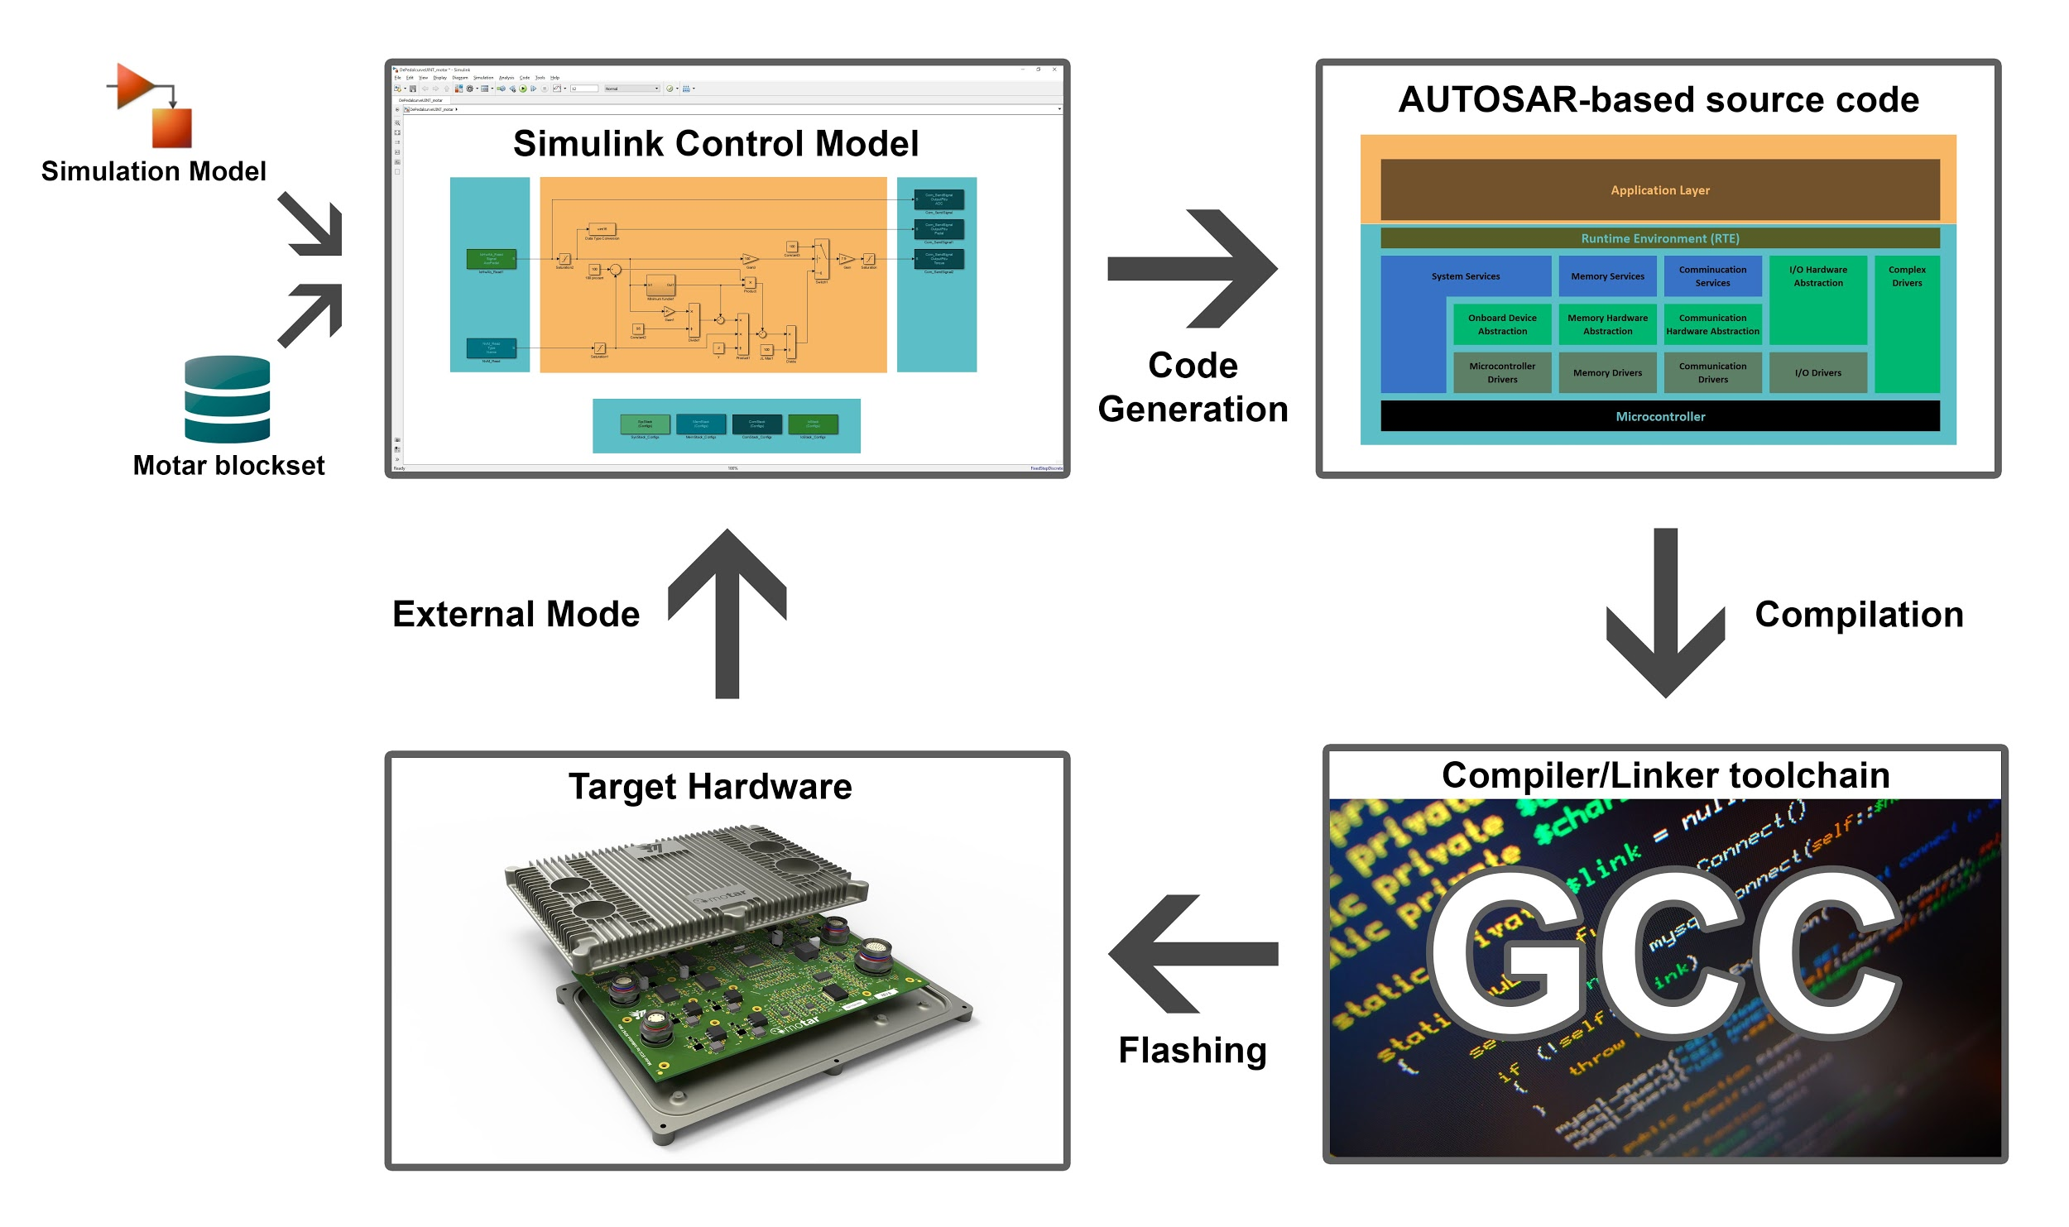
4. Embedded Coder :
Embedded Coder ® generates a readable, compact and fast C and C ++ code that can be used on embedded processors, target rapid prototyping cards and microprocessors used in mass production. Embedded Coder provides additional MATLAB Coder and Simulink Coder configuration options, as well as advanced optimizations to finely control the functions, files, and data of generated code. These optimizations improve code efficiency and facilitate integration with existing code, data types, and calibration settings used in production. It is possible to incorporate a third-party development environment into the compilation process to produce an executable.
Embedded Coder provides integrated support for AUTOSAR and ASAP2 software standards . It also provides traceability reports, code interface documentation and automated software verification to support DO-178, IEC 61508 and ISO 26262 software development.

Slide 48
Workflows for AUTOSAR with MATLAB & Simulink
This slide describes how you use Embedded Coder® software to configure a Simulink® representation of an AUTOSAR application for model-based design, and subsequently generate AUTOSAR-compliant code from the model.
Two typical workflows are :
The Round Trip Workflow : The round-trip workflow, in which you import AUTOSAR software components created by an AUTOSAR authoring tool (AAT) into the Simulink model-based design environment, and later export XML descriptions and C code for merging back into the AAT environment.
Bottom Up Workflow : The Simulink originated, or bottom-up, workflow, in which you take a model-based design that originated in Simulink, configure and evolve it for AUTOSAR code generation, and export XML descriptions and C code for use in the AUTOSAR environment.

Slide 49
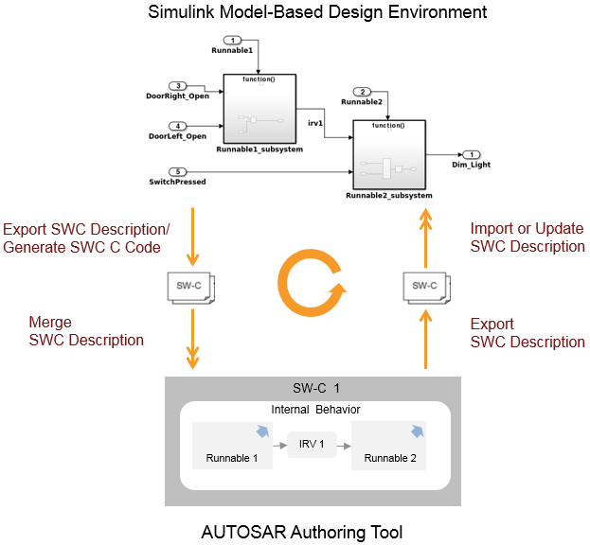
This figure describes The Round Trip Workflow :

Slide 50
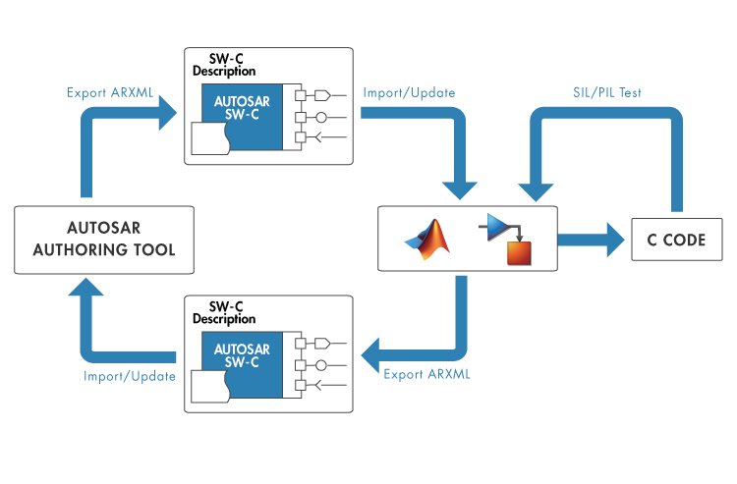
BOTTOM-UP APPROACH USING MATLAB AND SIMULINK FOR AUTOSAR MODELS

Slide 51
Simulink originated (bottom-up) workflow:
Develop the model using Simulink model-based design. This process includes configuring AUTOSAR elements, mapping Simulink model elements to AUTOSAR component elements, and validating the AUTOSAR configuration.
Model AUTOSAR Software Components
AUTOSAR Component Configuration
Design AUTOSAR Components, Simulate, and Generate Code (Embedded Coder Support Package for AUTOSAR Standard)
Modeling Patterns for AUTOSAR Runnables
Export the AUTOSAR component from Simulink, generating XML description files and C code files using Embedded Coder.
Generate AUTOSAR C and XML Files
Getting Started with AUTOSAR Code Generation
You can also verify your generated code in a simulation. See Verify AUTOSAR C Code with SIL

Slide 52
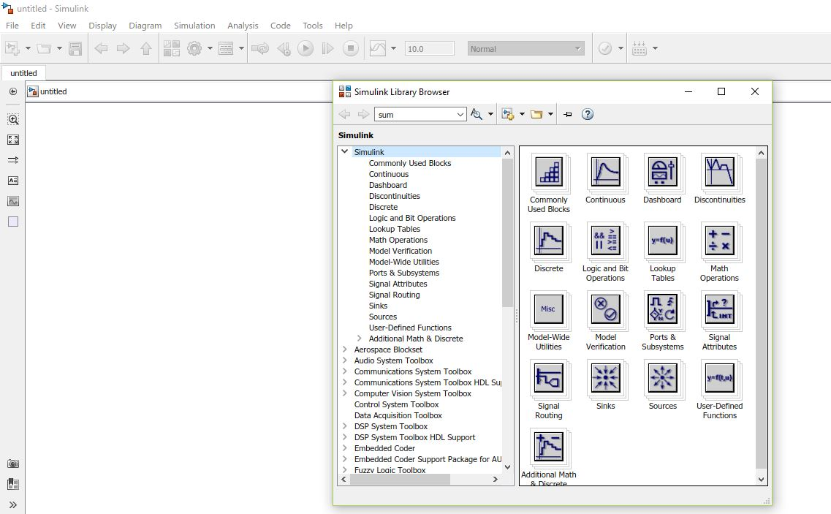
3.
Merge generated code and description files with other systems using an AUTOSAR authoring tool. You can use the authoring tool to export specifications, which can be imported back into Simulink. If the arxml code contains AUTOSAR software component changes, you can update the model to reflect the changes
Simulink Editor with Library Brower

Slide 53
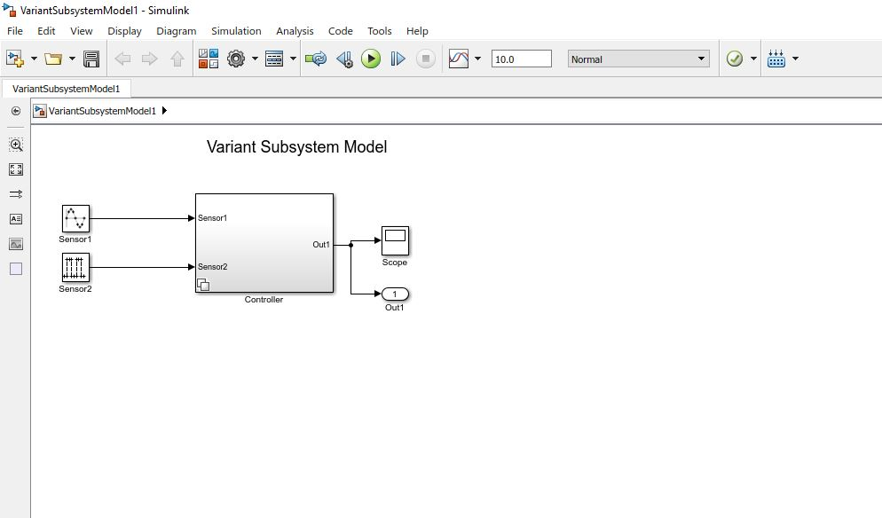
Detailed step by step explanation about the model I’ve created on Simulink using Bottom-Up Approach
Library Browser Button
This is the model I’ve created with the name “Variant Subsystem Model”.
This is a system named as Controller consisting of two subsystems

Slide 54
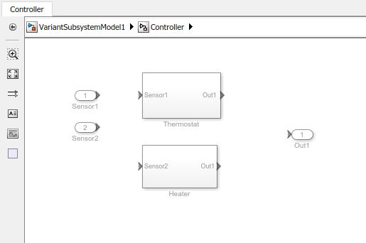
This is the input to subsystem Thermostat
These two are the subsystems of the system “Controller”.
This is the input to subsystem Thermostat
This is the output of the system. We can add a Scope from Library Browser for viewing the response of the system.

Slide 55
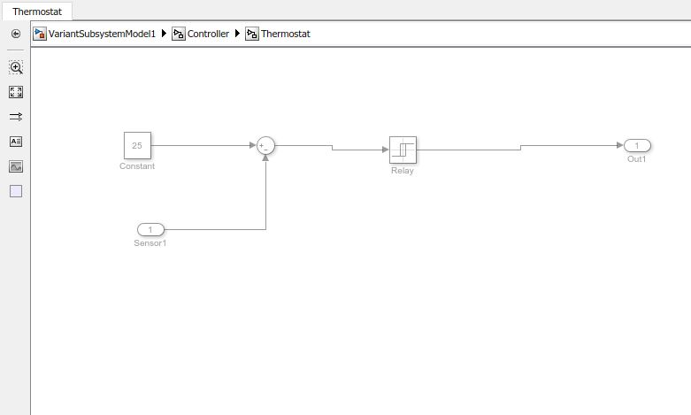
These are the connections inside the Thermostat Subsystem
Constant Block for providing constant value.
Output Block
Sum Block with +/- Signs
Relay Block
(The Relay block allows its output to switch between two specified values. When the relay is on, it remains on until the input drops below the value of the Switch off point parameter. When relay is off, it remains off until the input exceeds the value of the Switch on point parameter. The block accepts one input and generates one output.)
Input Block

Slide 56
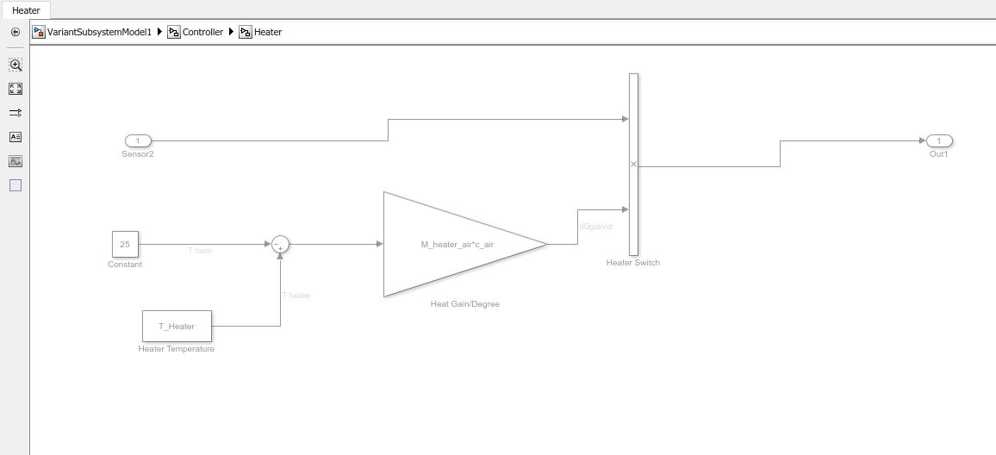
These are the connections inside the Heater Subsystem
Input Block
Output Block
Constant Block for providing constant value.
Mixer for multiply two values
We define all the parameters and constants in Model Explorer (we can find it in the tool menu)
Gain Block for multiplying two user defined parameters using in any mathematical expression.
Output the constant specified by ‘Constant Value' parameter

Slide 57
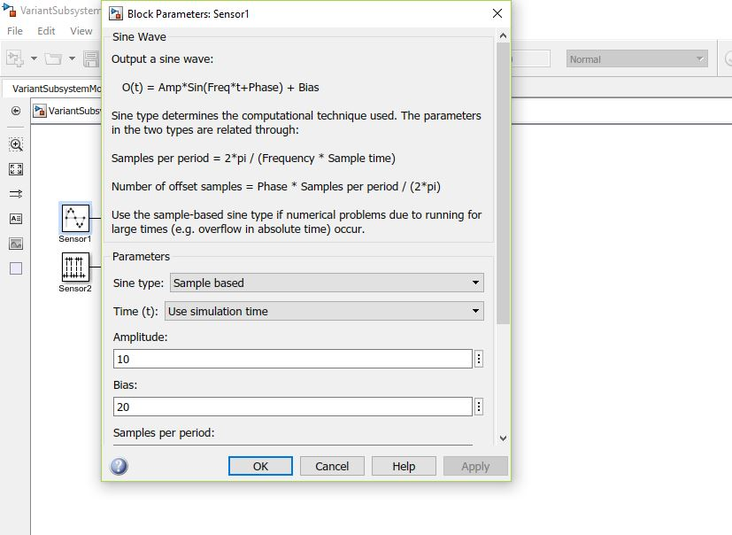
This is the example of giving sign wave as an input. Here we can see the expression is being used for defining the sine wave. So we just need to fill the value of the parameters.

Slide 58
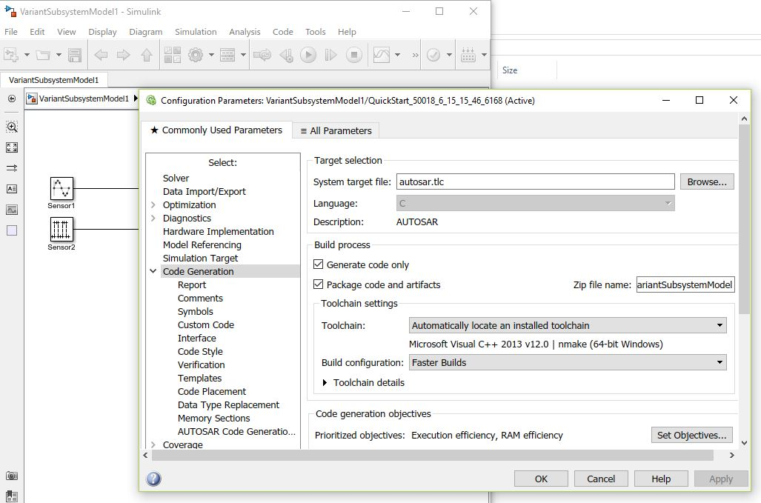
Configuration Parameter
Select “autosar.tlc” for AUTOSAR Code generation.
After generating the model, we go to configuration parameter menu for generation of AUTOSAR Code.

Slide 59
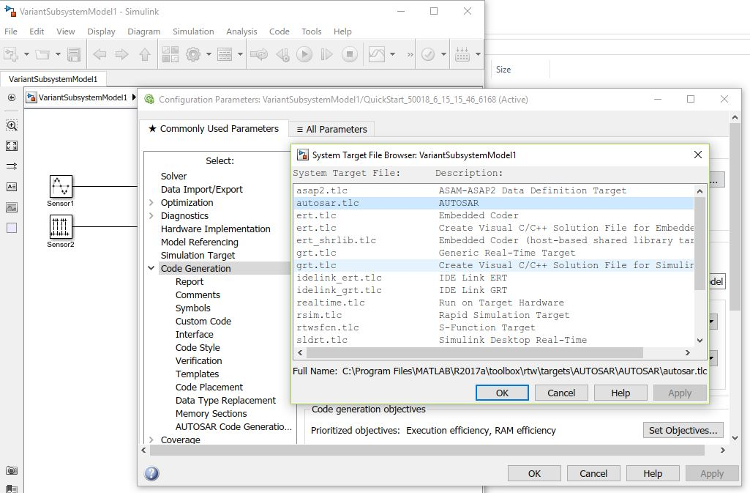

Slide 60
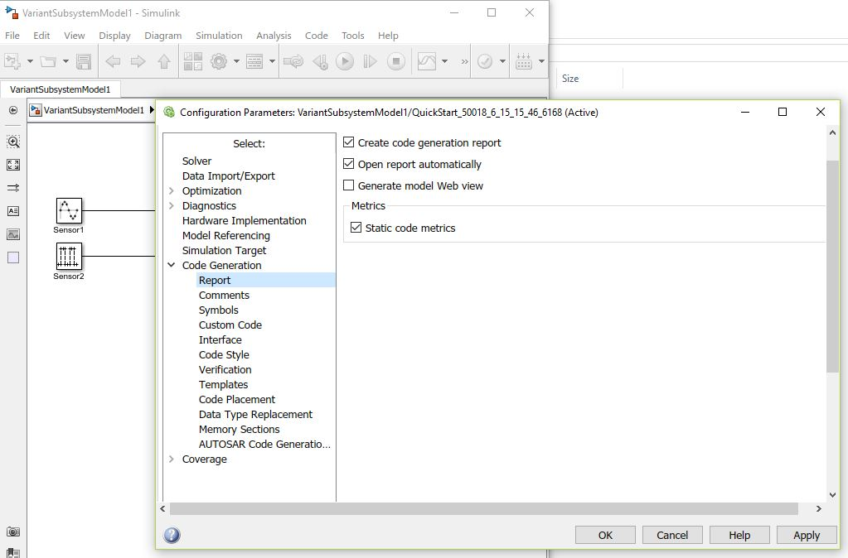
From the report section, tick the option “Create code generation report” and “Open report automatically”.

Slide 61
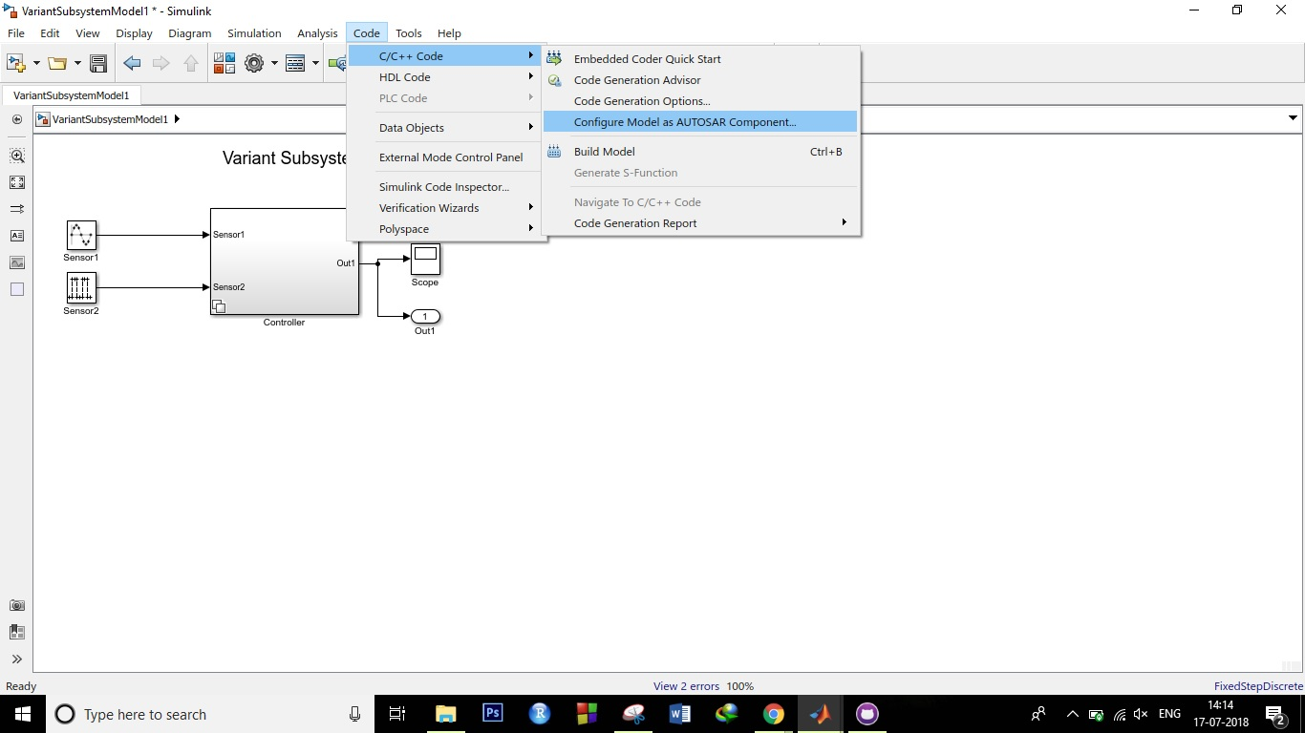
Before going to the AUTOSAR code generation stage, first configure the model components as “AUTOSAR Components” using this method.

Slide 62
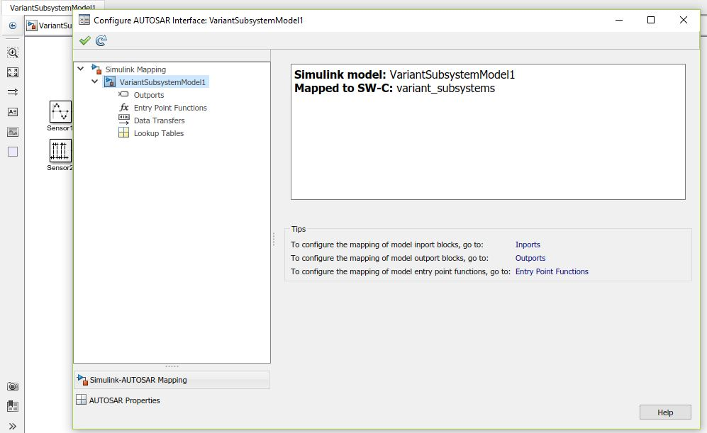
Configure all components by clicking this “green tick”.
We can check the AUTOSAR components mapping and their properties from here.

Slide 63
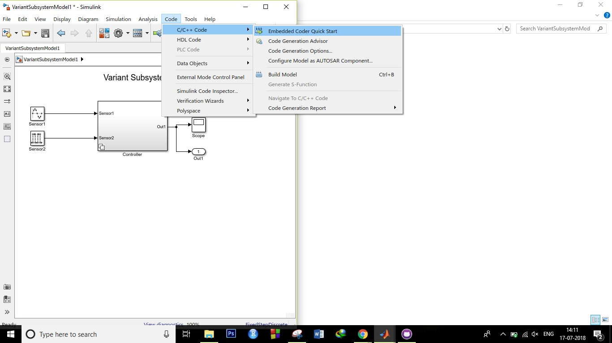
Now, for AUTOSAR code generation, Click on code and then “C/C++ Code” and the “Embedded Coder Quick Start”

Slide 64
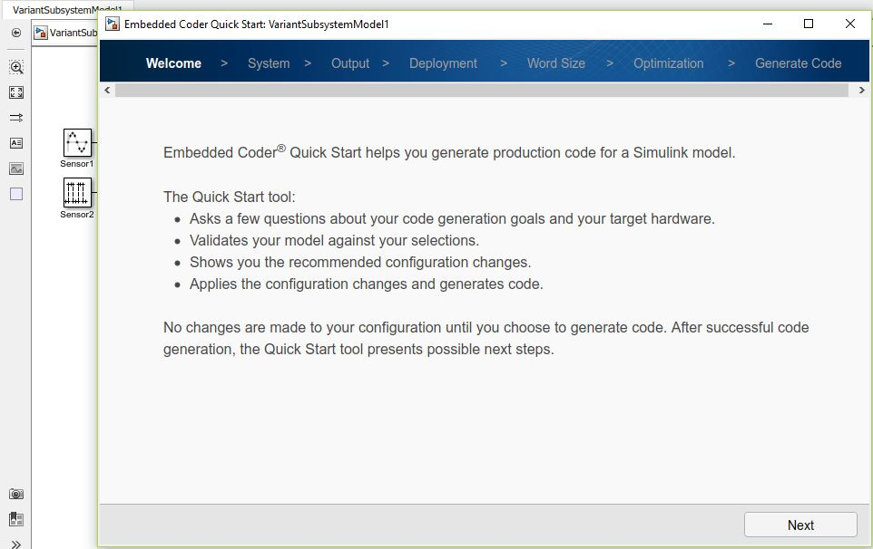
Click on the “Next”
This is the “Embedded Coder Quick Start” window

Slide 65

Again click on the “Next”

Slide 66

Select the option “C code compliant with AUTOSAR” for AUTOSAR Code Generation and then click “Next”

Slide 67

Keep clicking Next and reach the “Generate Code” tab.

Slide 68

Here, you’ll see the that Code Generation is completed.
Now, click on “Code Generate Report” for viewing the detailed info about the generated AUTOSAR code.
At this stage, a folder named as “YourModelName_autosar_rtw” containing C source code files and AUTOSAR XML files (ARXML) has been created in the working directory of MATLAB
Click Finish for closing this window.

Slide 69

This is how Code Generation Report look like.
These two are C source code and header file.
AUTOSAR XML (ARXML) files are contained here.

Slide 70

This is how “AUTOSAR XML file look like.

Slide 71



